Slide 1
OBJECT ORIENTED PROGRAMMING
PROJECT PRESENTATION
Abdullah Saeed 207599
Sami Mansoor Alavi 209433
Shifa Binte Shariq 211686

Slide 2
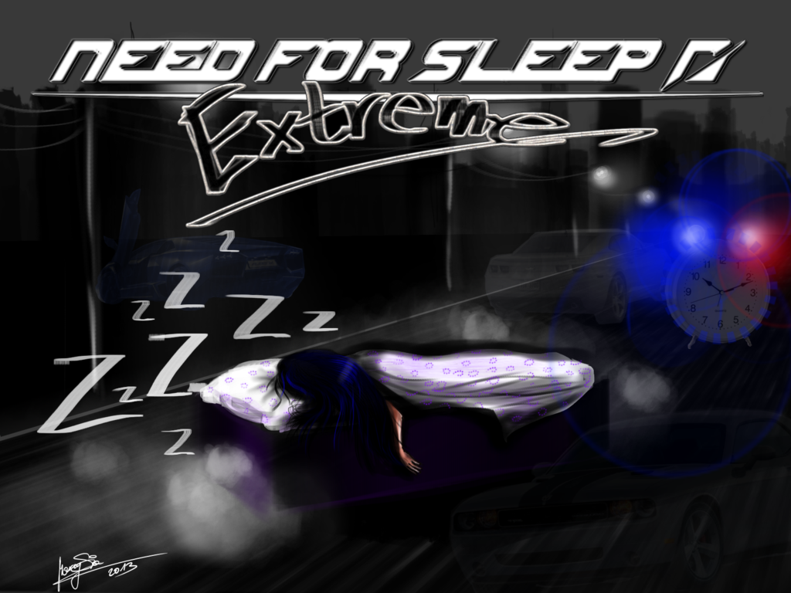

Slide 3
PROPSAL
Name:
Car racing game called “Need for Sleep”
Domain/Scope:
A game that helps the user to develop a sense of speed and traffic management to win the game.
Functional Requirements:
AWT Graphics Library
J-Swing Graphics Library
Javax Graphics and Sound Library

Slide 4
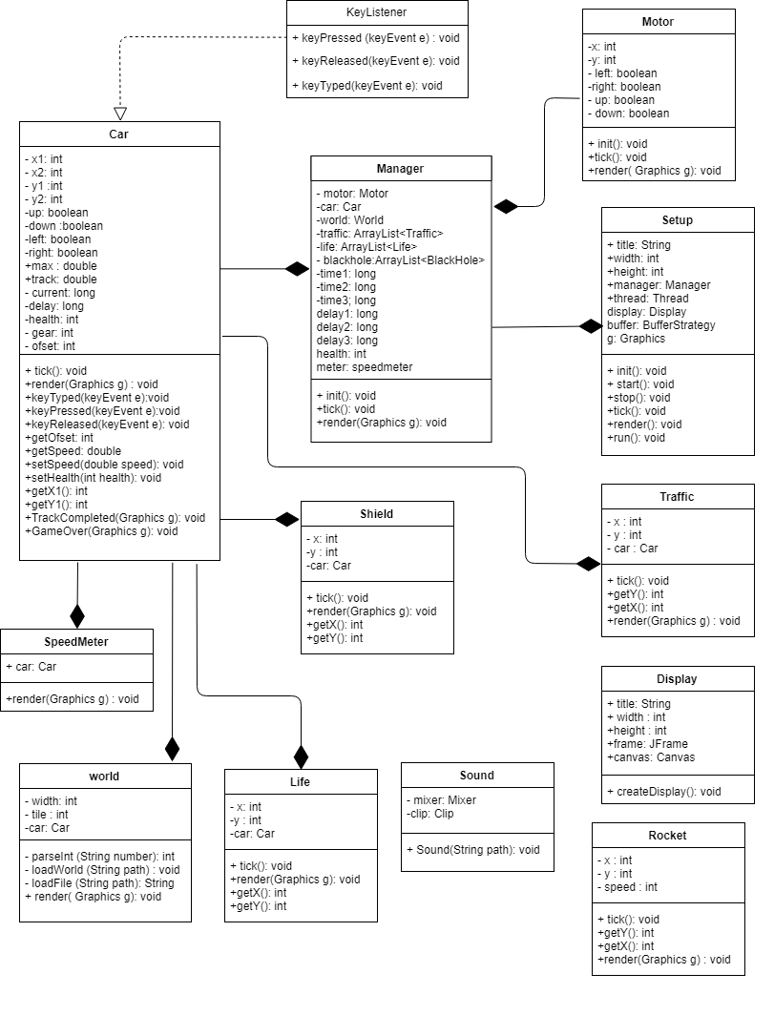
UML DIAGRAM

Slide 5
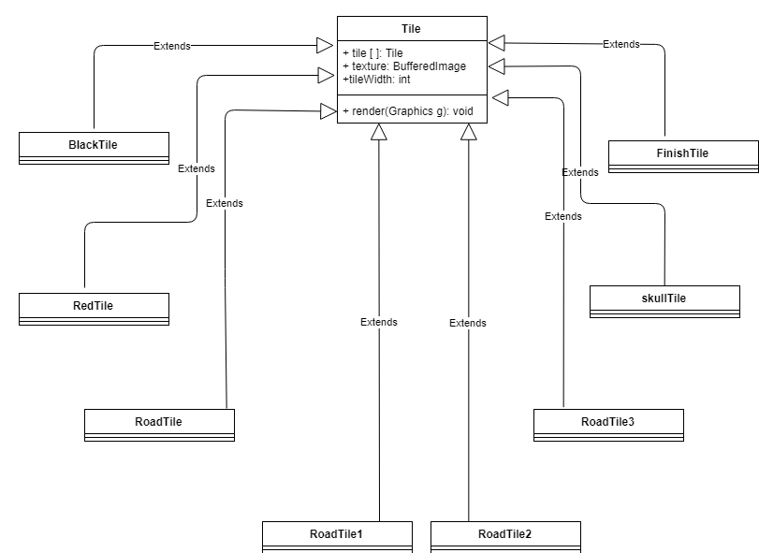
UML DIAGRAM Continued…

Slide 6
METHODOLGY
Acknowledgements:
Different forums, tutorials (http://zetcode.com/tutorials/javagamestutorial/)
Creation Of Graphics:
Our game is GUI based
Creation of a crop function
We took a bigger image that contained all the required images and created sub images from the function
The sub images are then played in any desired pattern
Other Functions:
keyPressed and keyReleased methods (acceleration, turning, braking)
init method (Sets up objects)
render method (Creation of images)
OOP Concepts Used In Descending Order:
Composition >Inheritance >Exception Handling>Implementation

Slide 7
CONCEPTS OF OOP MAPPED
Games And OOP:
No program can better map the concepts of OOP more effectively than a game. A game generally maps almost all the concepts of OOP.
Concepts In Our Game:
Composition
Inheritance
Polymorphism
Interface Implementation
File Handling
Exception Handling

Slide 8
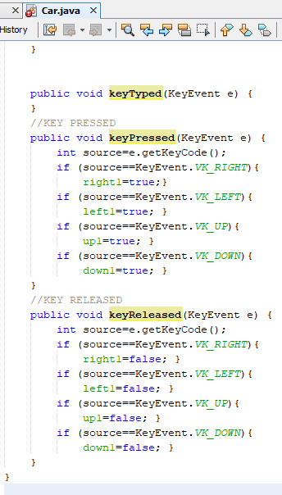
CODE SNIPPETS
Implementation of Interface
To handle the events generated by the keyboard inputs, the interface KeyListener has been implemented by the class Car. It enables the program to handle the events in favor of the game.

Slide 9
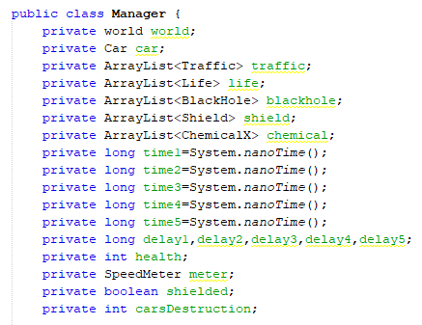
Composition
Composition provides a “has-a” relation between classes which is extremely useful when coding for a game. Many instances of this concept have been mapped such as:

Slide 10
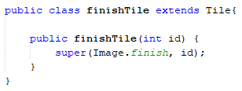
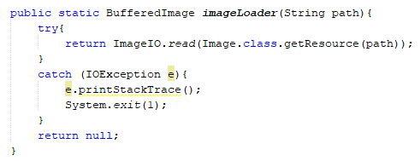
Inheritance
When loading images, inheritance concept was extensively used enabling the use of parent methods by the child classes.
Exception Handling
To avoid the crashing of code due to exceptions, exception handling has been used. It ensures the smooth running of game, even if unexpected events occur.

Slide 11
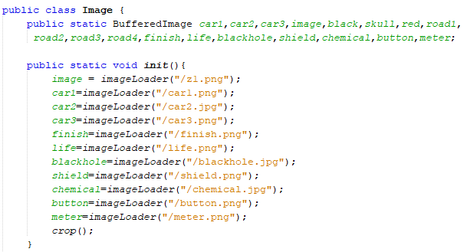
File Handling
In order to load graphics, background images and audios, many files have been read by using the methods of file handling such as:

Slide 12
SOFTWARE/ LIBRARY USED
Software Used:
Our code has entire been written on NetBeans.
Libraries Used:
Two GUI libraries:
AWT Graphics Library
Jswing Graphics Library
Javax Graphics and Sound Library

